Slide 1
Recursive Algorithms
CSC 113

Slide 2
Objectives
After we studied this chapter, we should be able to
  Write recursive algorithms for mathematical functions and nonnumerical operations.
  Understand the sequence of calls
  Decide when to use recursion and when not to.

Slide 3
Recursion
The factorial of N is the product of the first N positive integers:
        N * (N – 1) * (N – 2 ) * . . . * 2 * 1
The factorial of N can be defined recursively as
      1 if N = 1
      factorial( N ) =
      N * factorial( N-1 ) otherwise

Slide 4
Recursive Method
An recursive method is a method that contains a statement (or statements) that makes a call to itself.
Implementing the factorial of N recursively will result in the following method.
  public int factorial( int N ) {
  if ( N == 1 ) {
  return 1;
  }
  else {
  return N * factorial( N-1 );
  }
  }
Test to stop or continue.
End case: recursion stops.
Recursive case: recursion continues.

Slide 5
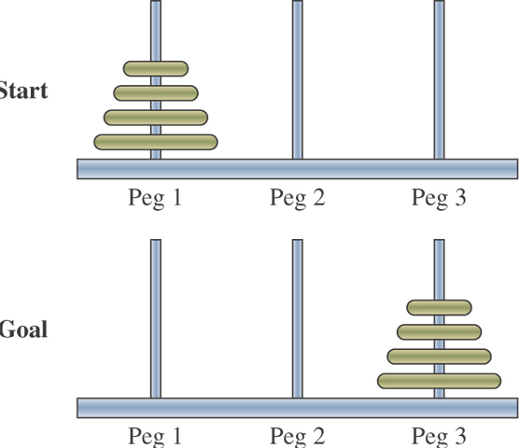
Towers of Hanoi
The goal of the Towers of Hanoi puzzle is to move N disks from peg 1 to peg 3:
You must move one disk at a time.
You must never place a larger disk on top of a smaller disk.

Slide 6
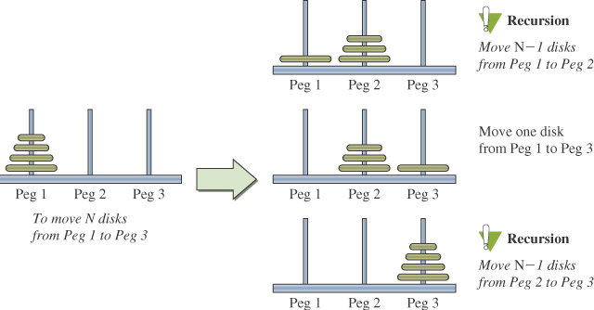
Towers of Hanoi Solution

Slide 7
towersOfHanoi Method
public void towersOfHanoi(int N, //number of disks
int from, //origin peg
int to, //destination peg
int spare ){//"middle" peg
if ( N == 1 ) {
moveOne( from, to );
} else {
towersOfHanoi( N-1, from, spare, to );
moveOne( from, to );
towersOfHanoi( N-1, spare, to, from );
}
}
private void moveOne( int from, int to ) {
System.out.println( from + " ---> " + to );
}
Test
End case
Recursive case

Slide 8
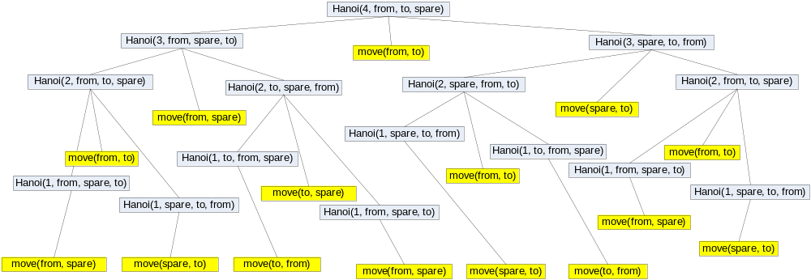
Recursion calls

Slide 9
Reversing a String - 1
public void displayBackward(int pos){
System.out.print("BackWard Begins with pos = " + pos) ;
if (pos == 0)
System.out.println("\t" +s.charAt(pos));
else {
System.out.println("\t"+ s.charAt(pos));
displayBackward(pos - 1);
}
System.out.println("BackWard Ends with pos = " + pos) ;
}

Slide 10
Reversing a String - 2
public void displayForeward(int pos){
System.out.println("Forward Begins with pos = " + pos) ;
if (pos == s.length() -1)
System.out.print("\t"+s.charAt(pos));
else {
displayForeward(pos + 1);
System.out.print("\t"+s.charAt(pos));
}
System.out.println("Forward Ends with pos = " + pos) ;
}

Slide 11
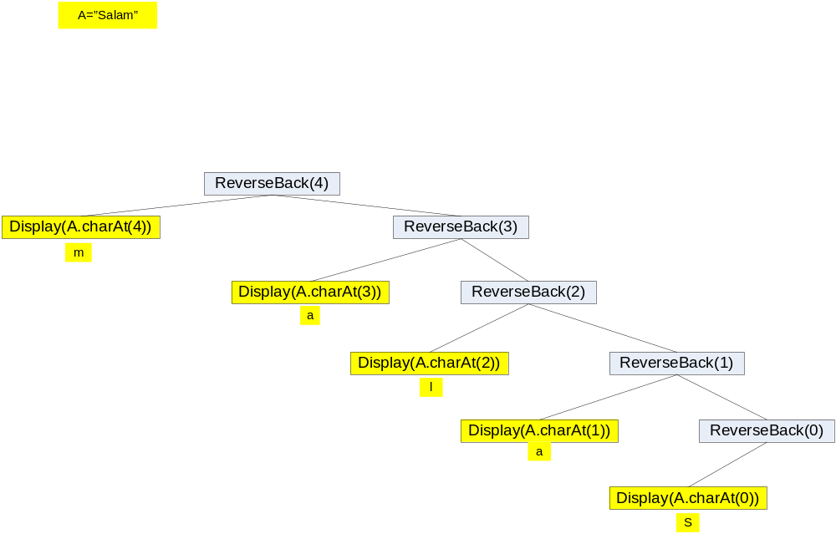
Calls Sequence -1

Slide 12
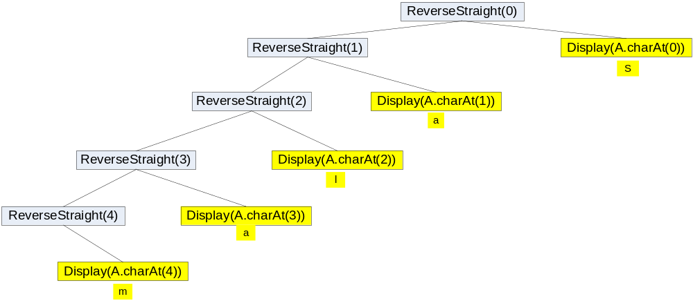
Calls Sequence -2

Slide 13
When Not to Use Recursion
When recursive algorithms are designed carelessly, it can lead to very inefficient and unacceptable solutions.
For example, consider the following:
public int fibonacci( int N ) {
if (N == 0 || N == 1) {
return 1;
} else {
return fibonacci(N-1) + fibonacci(N-2);
}
}

Slide 14
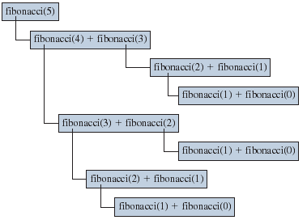
Excessive Repetition
Recursive Fibonacci ends up repeating the same computation numerous times.

Slide 15
Nonrecursive Fibonacci
public int fibonacci( int N ) {
int fibN, fibN1, fibN2, cnt;
if (N == 0 || N == 1 ) {
return 1;
} else {
fibN1 = fibN2 = 1;
cnt = 2;
while ( cnt <= N ) {
fibN = fibN1 + fibN2; //get the next fib no.
fibN1 = fibN2;
fibN2 = fibN;
cnt ++;
}
return fibN;
}
}

Slide 16
When Not to Use Recursion
In general, use recursion if
  A recursive solution is natural and easy to understand.
  A recursive solution does not result in excessive duplicate computation.
  The equivalent iterative solution is too complex.

